Slide 1
POST 3665
RACELAND, LOUISIANA
COMMUNITY SERVICE REPORT

Slide 2
COMMUNITY SERVICE ENTRY FORM
POST: 3665
STATE: LOUISIANA
POPULATION: 10,000.00
TOTAL PROJECTS:
TOTAL PERSONS SERVED:
TOTAL FUNDS USED/DONATED:
TOTAL HOURS WORKED:
TOTAL POST & AUX WORKERS AS OF:

Slide 3
MAY 2021
COMMUITY SERVICE: YES
CITIZENSHIP EDUCATION: YES
SAFETY PROGRAMS:
YOUTH ACTIVITIES:
NAMS:
LEGISLATIVE ACTION
HOSPITAL: YES
MOTORCYLE RIDERS GROUP:

Slide 4
MAY 2021
TOTAL PERSONS SERVED: 15 TOTAL FUNDS USED/DONATED: $1830.61 TOTAL HOURS WORKED: 24
Community Service - 5/1/2021 - Other school or church assistance - Comrade Dalgo volunteered his time at Church reaching the community about Veterans.
Community Service - 5/2/2021 - Other school or church assistance - Comrade Dalgo volunteered to serve on the hospitality team at Hope church serving coffee, opening doors, and serving coffee.
Hospital - 5/3/2021 - Visit Veterans (Hosp & Home) - Comrade Dalgo check on and visited an older Veteran in the community.
Community Service - 5/4/2021 – Aide to others - Comrade Lamey brought a special needs man Brian Pierce to work.
Community Service - 5/11/2021 - Aid to others - Comrade Lamey brought a special-needs man Brian Pierce to work.
Hospital - 5/13/2021 - Visit Veterans (Hosp & Home) - Comrade Dalgo checked on and visited a WWII Veteran at his residence.
Community Service - 5/16/2021 - Other school or church assistance - Comrade Dalgo and Lamey volunteered their time to set up church and serve on the hospitality serving coffee, food & etc…
Hospital - 5/18/2021 - Visit Veterans - Comrade Dalgo check on and visited another older veteran at the community.
Citizenship Education - 5/20/2021 - Fly POW/MIA Flag – Flew POW flag everyday of the month and performed a small ceremony during meeting. Also fallen Soldier display.
Community Service - 5/23/2021 - Other school or church assistance - Comrade Dalgo and Lamey volunteered to set up church and serve on the hospitality team at Hope church serving coffee opening doors and greeting.
Community Service - 5/26/2021 - Cooperated in other organizations fund raiser - Donated a customized ice chest to the Combat Veterans Motorcycle Association for the upcoming Region 5 rally.
Community Service - 5/29/2021 - Other community involvement - Donated the Hall to a member in the community George Hurley retiring from the military.

Slide 5
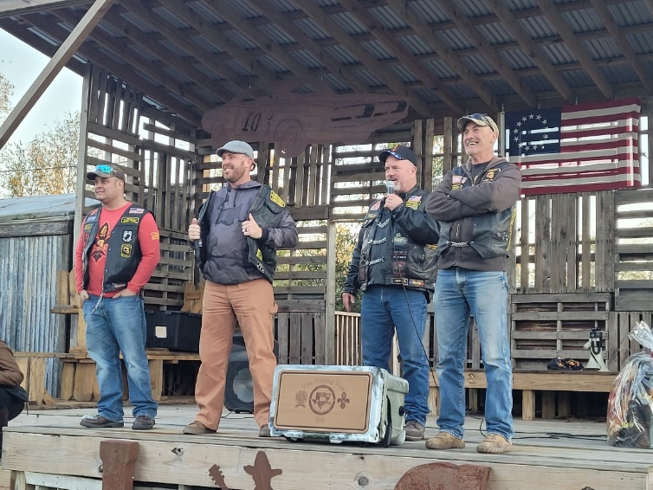
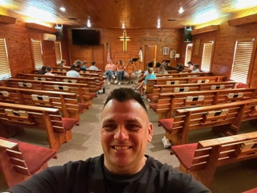
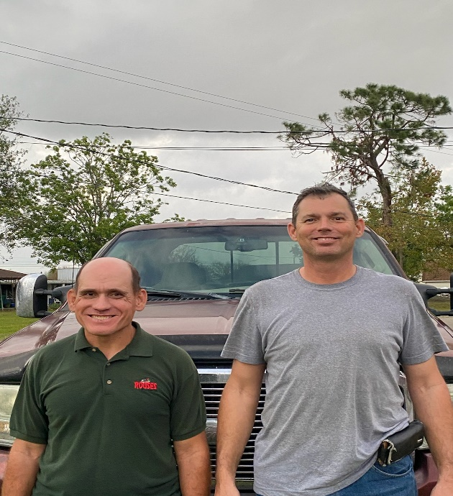
Donated a custom made ice chest to the Combat Veterans Motorcycle Association Chapter 6-4 for their upcoming Region 5 Rally. C.V.M.A supports our the VFW, other VSO’s and charity organizations, therefore provided them with an auction item. $347.28.
Post Chaplin and Comrade Douglas Lamey getting to Hope Church early; Volunteering for set up and the hospitality team serving coffee/refreshments.
Comrade Douglas Lamey giving a ride often to a local disabled person (Brian Pierce). Gives him a ride to work at the local Rouses Supermarket and other places.

Slide 6
JUNE 2021
COMMUITY SERVICE: YES
CITIZENSHIP EDUCATION: YES
SAFETY PROGRAMS:
YOUTH ACTIVITIES:
NAMS:
LEGISLATIVE ACTION
HOSPITAL: YES
MOTORCYLE RIDERS GROUP:

Slide 7
JUNE 2021
TOTAL PERSONS SERVED: 63 TOTAL FUNDS USED/DONATED: $2375.38 TOTAL HOURS WORKED: 44
Community Service - 6/7/2021 - Aid to others – Comrade Dalgo gave two free haircuts to individuals in the community in need.
Community Service - 6/8/2021 - Other school or church assistance – Comrade Dalgo volunteered his time to teach a youth group and also served them snacks
Community Service - 6/11/2021 - Aid to others - Comrade Lamey brought a special needs man Brian Pierce to work.
Community Service - 6/12/2021 - Aid to others – Comrade Dalgo volunteered to help tear out walls at Hope Church so they can remodel.
Community Service - 6/12/2021 - Other school or church assistance – Comrade Dalgo and Lamey volunteered their time to help set up for church and serve on the hospitality team serving coffe, food and etc...
Community Service - 6/13/2021 - Aid to persons or family with tragedy / illness - Donated $100.00 to the spouse of a deceased member to assist with funeral expenses.
Community Service - 6/13/2021 - Cooperated in other organizations fund raiser - Donated $50.00 to the Raceland Branch Library for a children's fund raiser.
Community Service - 6/16/2021 - Aid to others - Member donated 2 hours serving subpoenas on behalf of local veterans and first responders in the area.
Community Service - 6/16/2021 - Aid to others - Comrade Lamey brought a special need man Brian Pierce to work.
Community Service - 6/16/2021 - Aid to persons or family with tragedy / illness - Donated $100.00 to the spouse of a deceased member (Delvin Hotard) to assist with funeral expenses.
Citizenship Education - 6/17/2021 - Fly POW/MIA Flag - Flew POW flag every day of the month. Also POW ceremony during meeting at the Post.

Slide 8
JUNE 2021
Community Service - 6/19/2021 - Aid to others – Comrade Dalgo donated used clothes and toys to a little girl in the community in need.
Community Service - 6/19/2021 - Aid to others - Comrade Dalgo checked on disable veteran in the community.
Community Service - 6/19/2021 - Aid to others - Threw a surprise birthday party for a 96-year-old birthday party for WWII Veteran Tony Jaber that served in Air force and the Army -that is about to move away. -Invited others in the community to honor him!!
Community Service - 6/20/2021 - Other school or church assistance - Comrade Dalgo and Lamey volunteered to help set up church and serve on the hospitality team serving coffee, food & etc…
Community Service - 6/21/2021 - Aid to persons or family with tragedy / illness – Comrade Dalgo counseled an Air Force Veteran. His wife threw him out the house. Veteran not thinking straight. -He is on a lot of different medications. –Brought to the VA and see his mental health Doctor.
Community Service - 6/21/2021 - Aid to others – Comrade Dalgo helped a 96-year-old WWII Veteran Tony Jaber’s load personal belongings in a trailer because he is moving.
Community Service - 6/23/2021 - Aid to others – Comrade Dalgo cooked for neighbors and 8 others helping the WWII Veteran move.
Community Service - 6/24/2021 - Other community involvement - Donated the Axillary building to Ochsner Health to administer Covid vaccinations to the community. Members of the community received their Covid vaccinations.
Hospital - 6/28/2021 - Visit Veterans (Hosp & Home) – Comrade Dalgo cut hair at the Luling Nursing home and one was a WWII Veteran 95 years old.
Community Service - 6/28/2021 - Aid to others – Comrade Dalgo gave 2 haircuts to people in the community who were in need of services.
Community Service - 6/30/2021 - Other school or church assistance – Comrade Dalgo volunteered to lead youth services at Hope Church. Cooked corndogs and mac n cheese -set up and broke down for youth event at church open to the community.

Slide 9
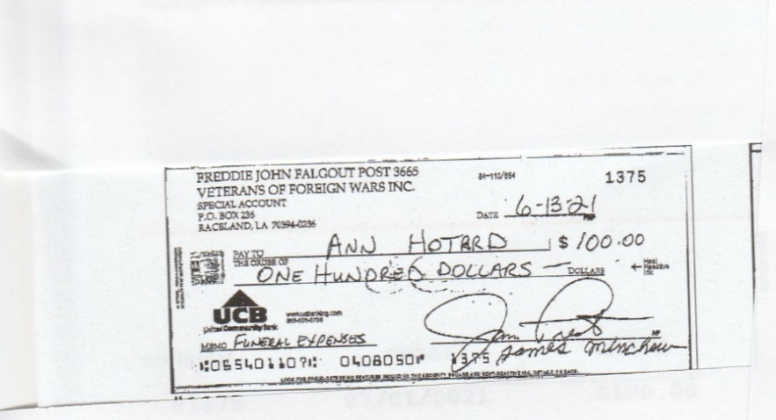
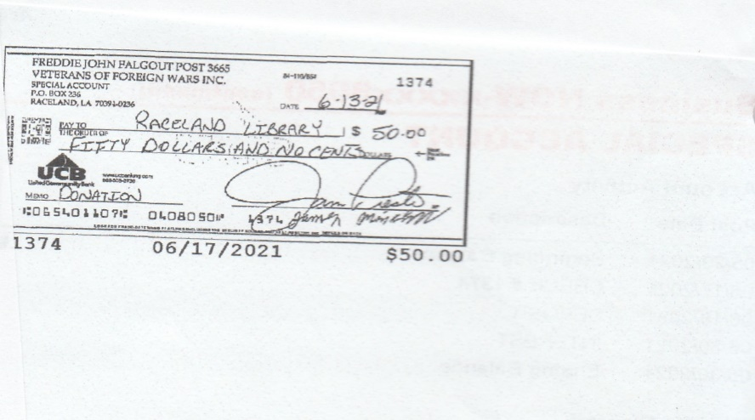
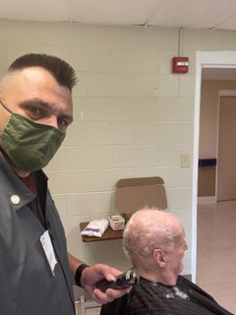
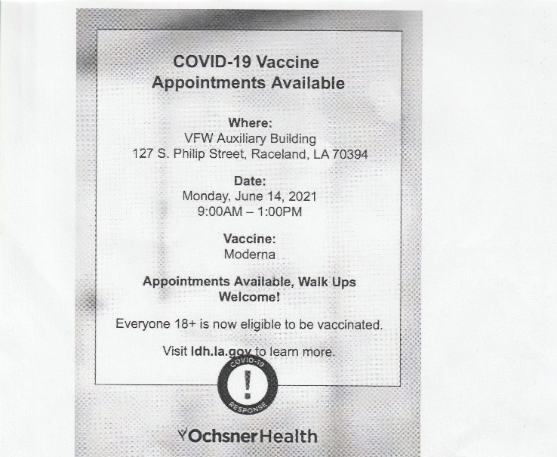
Donations: $100.00 to deceased member Delvin Hotard to assist with expenses and $50.00 to a children’s fundraiser at Raceland Library.
Post Chaplin providing free haircuts to elderly members of the Luling nursing home including WWII vet Tony Jaber.
Donated our Auxiliary building to Oshner Health to administer Covid-19 vaccinations to the community.

Slide 10
JULY 2021
COMMUITY SERVICE: YES
CITIZENSHIP EDUCATION: YES
SAFETY PROGRAMS:
YOUTH ACTIVITIES: YES
NAMS:
LEGISLATIVE ACTION
HOSPITAL: YES
MOTORCYLE RIDERS GROUP:

Slide 11
JULY 2021
TOTAL PERSONS SERVED: 36 TOTAL FUNDS USED/DONATED: $1967.40 TOTAL HOURS WORKED: 60
Community Service - 7/2/2021 - Aid to persons or family with tragedy / illness - Donated a casket flag and case to the son of a fallen Veteran. Package and shipped the flag and case to his son.
Community Service - 7/5/2021 - Aid to persons or family with tragedy / illness - Donated $100.00 to the family of a deceased VFW member to assist with funeral expenses.
Community Service - 7/7/2021 - Aid to persons or family with tragedy / illness - Donated a casket flag case to a deceased member’s family.
Citizenship Education - 7/15/2021 - Fly POW/MIA Flag - Flew POW flag every day at the Post and had a ceremony. Also fallen Soldier display table set up.
Community Service - 7/20/2021 - Aid to others – Comrade Dalgo provided two free haircuts to individuals who were attending a funeral due to a death in the family.
Hospital - 7/21/2021 - Visit Veterans (Hosp & Home) – Comrade Prestenback checked on a member Edward Orgeron battling cancer at his residence. Sat with member about an hour.
Community Service - 7/21/2021 - Other school or church assistance – Comrade Dalgo volunteered his tim to pack and take 18 kids youth trip on a youth trip. Also taught lessons to the youth.
Community Service - 7/21/2021 - Aid to others - Comrade Dalgo volunteered his time to mow an elderly couples grass in the community.
Community Service - 7/23/2021 - Other school or church assistance – Comrade Dalgo Youth Retreat continues – Feeding them and teaching lessons - Baptizing 2 of them.
Community Service - 7/24/2021 - Other school or church assistance – Comrade Dalgo volunteered his time help the local church with construction..
Community Service - 7/24/2021 - Other school or church assistance – Comrade Dalgo taught lessons at the Youth Retreat outh retreat taught a lesson. He fed them breakfast -packed up camp and kids -drove back to church unloaded.
Community Service - 7/26/2021 - Aid to others - Comrade Lamey brought a special-needs man Brian Pierce to work.
Community Service - 7/29/2021 - Aid to others - Comrade brought special-needs man to work.

Slide 12
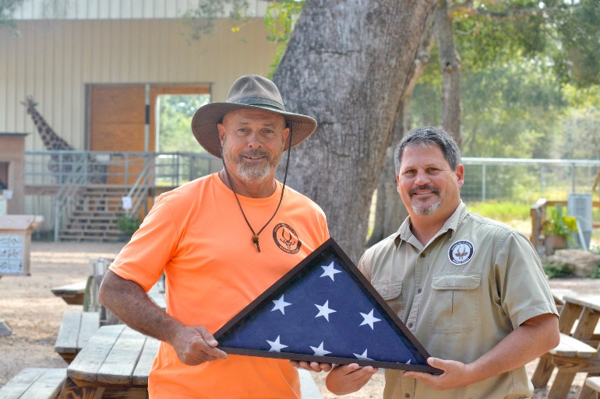
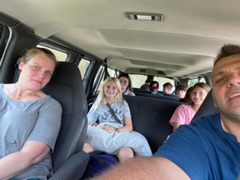
Post donated a casket flag and case to the son of a fallen Veteran.
Donated $100.00 to the family of deceased member Gatewood “Pot” Folse to assist with funeral expenses.
Post Chaplin volunteering his time to take 18 children on a youth church retreat. Teaching our youth.

Slide 13
AUGUST 2021
COMMUITY SERVICE: YES
CITIZENSHIP EDUCATION: YES
SAFETY PROGRAMS:
YOUTH ACTIVITIES: YES
NAMS:
LEGISLATIVE ACTION
HOSPITAL:
MOTORCYLE RIDERS GROUP:

Slide 14
AUGUST 2021
TOTAL PERSONS SERVED: 163 TOTAL FUNDS USED/DONATED: $3,397.23 TOTAL HOURS WORKED: 101
Community Service - 8/1/2021 - Other school or church assistance - Comrade Dalgo volunteered his time at Hope church early to repair broken things. He also served and broke things down at church before and after services.
Community Service - 8/1/2021 - Other school or church assistance – Comarde Dalgo volunteered his time and taught bible classes at Hope Church in two separate locations
Community Service - 8/2/2021 - Aid to others - Comrade Lamey brought a special-needs man Brian Pierce to work.
Community Service - 8/2/2021 - Aid to persons or family with tragedy / illness – Comrade Dalgo learned of an individual in the community with Covid. He purchased and brought the individual medicine.
Community Service - 8/4/2021 - Aid to others - Cleaned up around the church. – Comrade Dalgo volunteered his time to clean up after Church and police call the grounds.
Youth Activities - 8/5/2021 - Scholarships/merits awarded - Local Scholarship paid to Seth Prestenback. Attending Nicholas State University and majoring in Education.
Community Service - 8/6/2021 - Other school or church assistance – Comrade Dalgo volunteered his time to pick materials up for church so they can remodel.
Community Service - 8/7/2021 - Provided military Funeral Honors - Two comrades attended and participated in a member’s funeral. Also presented the family with a casket flag case.
Community Service - 8/7/2021 - Other cooperative project - Partnered with VFW Post 3750, 7717, 7717, 3693 and 3784 to prepare a meal for Army Reserve Soldiers deploying Oconus. Attended their mobilization ceremony and provided a meal to 35 soldiers & 100 families members. Prepared jambalaya and whites beans.
Community Service - 8/8/2021 - Aid to others – Comrade Dalgo volunteered his time before church to help set up and served on the hospitality team serving guest coffee, drinks & etc…
Youth Activities - 8/9/2021 - Scholarships/merits awarded - Local scholarship paid to Cullen Breaux. $125.00.

Slide 15
AUGUST 2021 (CONTINUED)
Community Service - 8/9/2021 - Other community involvement – Comrade Daglo volunteered his time to say a Prayer and Pledge at the Parish Council Meeting.
Community Service - 8/11/2021 - Other school or church assistance – Comrade Dalgo volunteered his time teaching a small youth group. Also provided them snacks and cleaned up after.
Community Service - 8/12/2021 - Aid to others – Comrade Dalgo gave a Veteran in the community a free haircut.
Community Service - 8/16/2021 - Aid to others – Comrade Dalgo cooked for a family in the community in need.
Community Service - 8/17/2021 - Aid to others - Comrade Lamey brought a special-needs man Brian Pierce to work.
Youth Activities - 8/19/2021 - Other youth activities - Donated $50.00 to a members granddaughter for a school fund raiser at Raceland Middle School.
Citizenship Education - 8/19/2021 - Fly POW/MIA Flag - Flew POW flag every day at our VFW Post. Also set up Fallen Soldier and POW memorial during our monthly meeting.
Community Service - 8/20/2021 - Aid to others - Comrade Lamey brought a special-needs man Brian Pierce to work.
Community Service - 8/22/2021 - Other school or church assistance – Comrades Dalgo and Lamey volunteered their time to help set up church and serve on the hospitality team serving coffee, drinks & etc...
Community Service – 8/23/2021 – Aid to others – Comrade Dalgo cut one older Veterans and elderly ladies yard. Also done some handy work around their house.
Youth Activities - 8/25/2021 - Patriot’s Pen - Post chairman visited 5 local schools in the area to delivery Patriot Pen material. St Charles, Holy Savior, St Mary, Raceland Upper and Lockport Lower Elementary Schools.
Community Service - 8/25/2021 - Other school or church assistance - Setup and taught at youth night at church.
Youth Activities - 8/25/2021 - Americanism Cat1 - Post Chairman visited 5 local schools and provided material for the Americanism program. St Charles, Holy Savior, St. Mary, Raceland Upper and Lockport Lower Elementary schools.
Community Service – 8/27/2021 – Aid to others – Comrade Lamey brought a special needs man Brian Pierce to work.

Slide 16
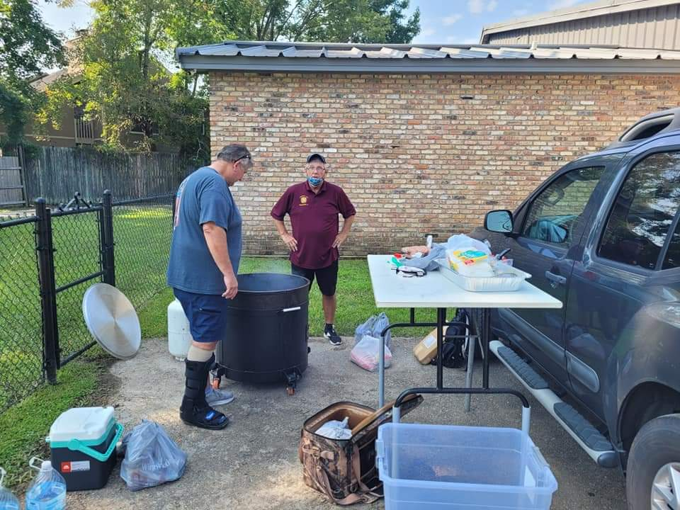
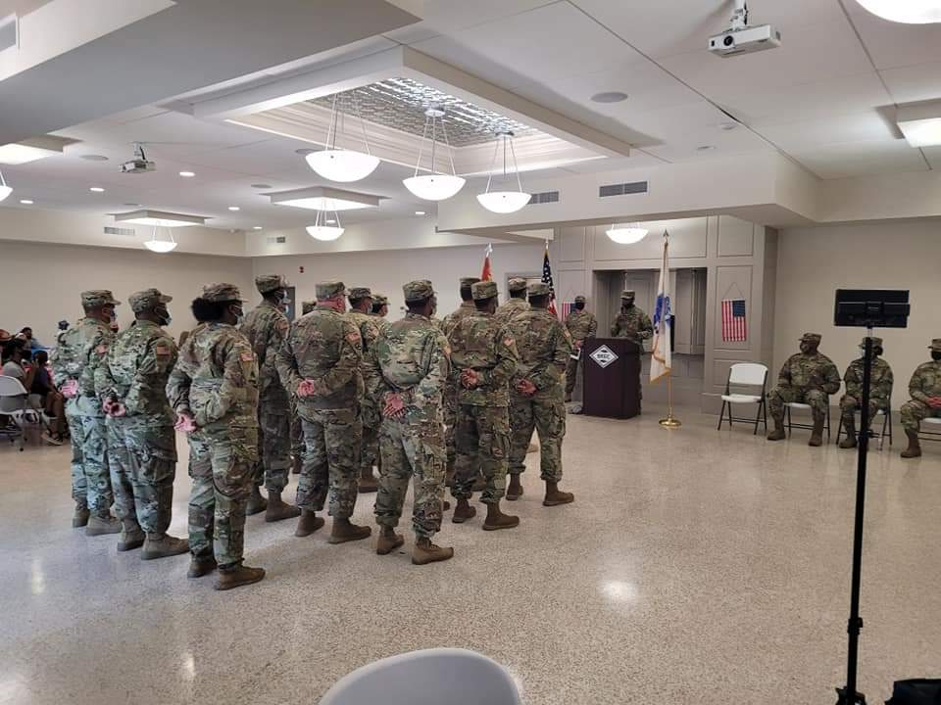
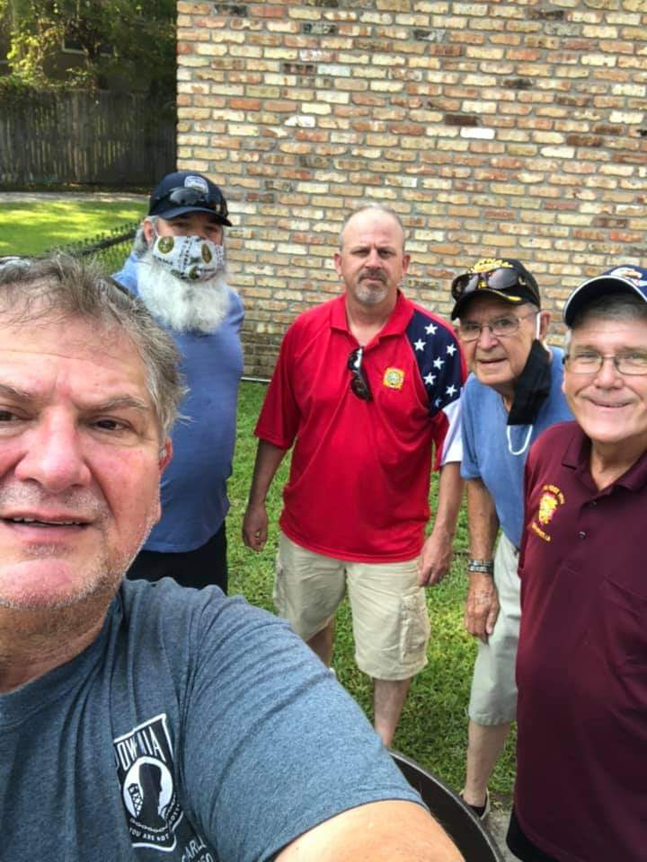
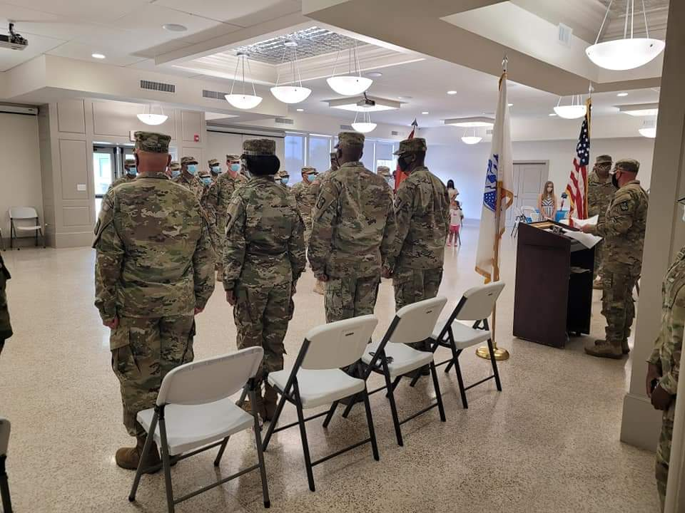
Partnered with VFW Post 3750, 7717, 7717, 3693 and 3784 to prepare a meal for Army Reserve Soldiers deploying Oconus. Attended their mobilization ceremony and provided a meal to 35 soldiers & 100 families members. Prepared jambalaya and whites beans.
Paid local scholarships

Slide 17
SEPTEMBER 2021
COMMUITY SERVICE: YES
CITIZENSHIP EDUCATION:
SAFETY PROGRAMS:
YOUTH ACTIVITIES:
NAMS:
LEGISLATIVE ACTION
HOSPITAL: YES
MOTORCYLE RIDERS GROUP:

Slide 18
SEPTEMBER 2021
TOTAL PERSONS SERVED: 1,000 plus TOTAL FUNDS USED/DONATED: $27,315.06 TOTAL HOURS WORKED: 191
Community Service - 9/1/2021 - Aid to others - Help single lady tarp roof.
Community Service - 9/1/2021 - Aid to others - Help tarp a roof for a senior on his house and shed.
Community Service - 9/2/2021 - Aid to others - Helped veteran pull out sheetrock.
Community Service - 9/2/2021 - Aid to others - Comrades tarped 3 veterans' roofs.
Community Service - 9/2/2021 - Aid to others - Comrade helped clear the neighbor's yard.
Community Service - 9/3/2021 - Aid to others - Comrades and Auxiliary members distributed water and gasoline to members, veterans and community members for Hurricane IDA relief efforts.
Community Service - 9/4/2021 - Aid to others - Partnered up with other VFW Post to receive food and supplies to distribute to local Veterans and community. Distributed supplies to family in need.
Community Service - 9/4/2021 - Aid to others - Helped neighbors pull branches out to the road so they are able to get in the house.
Community Service - 9/5/2021 - Aid to others - Distributed food and supplies to members, Veterans and the Community for Hurricane Ida relief efforts.
Community Service - 9/6/2021 - Aid to others - Comrades help throughout the community clearing debris.
Community Service - 9/6/2021 - Aid to others - Received food and supplies from other VFW Post. Arranged the supplies at the Post to be distributed to members, Veterans and the community for Hurricane Relief efforts.
Community Service - 9/6/2021 - Aid to others - Partnered with the Combat Veterans Motorcycle Association Chapter 6-8 to receive food and supplies for members, Veterans and community members for Hurricane Ida relief efforts.
Community Service - 9/6/2021 - Aid to others - Handed out water and snack to other volunteer groups during Ida.
Community Service - 9/7/2021 - Aid to others - Distributed food and supplies to members, Veterans and the community for Hurricane Relief efforts.
Community Service - 9/8/2021 - Aid to others - Partnered with the Marine Corps League in Houma, La to distribute food and supplies to their members and Terrebonne Parish community for Hurricane relief efforts. They received food and supplies from the VFW to distribute.
Community Service - 9/8/2021 - Aid to others - cut trees out of an older gentlemen’s yard (Ida)
Community Service - 9/9/2021 - Aid to others - Auxiliary members served snowballs to all lineman and workers on LA 1 near Hwy 90 in Raceland who were working to restore power and critical infrastructure post Hurricane Ida

Slide 19
SEPTEMBER 2021 (CONTINUED)
Community Service - 9/10/2021 - Aid to others - helped veterans service their generator and gave them 10 gallons of gas.
Community Service - 9/10/2021 - Aid to others - Unloaded trucks that had supplies on them at the church so they can be handed out.
Community Service - 9/10/2021 - Aid to others - Comrades and Auxiliary members partnered with the American Red Cross to receive and distribute cleaning supplies to members, Veterans and community for Hurricane Ida relief efforts.
Community Service - 9/11/2021 - Aid to others - Brought supplies to others (Ida)
Community Service - 9/11/2021 - Aid to others - Comrades and Auxiliary members partnered up with the American Red Cross to receive and distribute cleaning supplies to members, Veterans and the community for Hurricane Ida relief efforts.
Community Service - 9/12/2021 - Aid to others - Comrades and Auxiliary members received supplies from the Louisiana National Guard (Red Cross) to distribute to the community for Hurricane Ida relief efforts.
Community Service - 9/13/2021 - Aid to others - Comrades and Auxiliary members Partnered with the American Red Cross to serve hot meals to the community for Hurricane Ida relief efforts. Auxiliary members also brought food to needy families in the community. Donated our hall.
Community Service - 9/13/2021 - Aid to others - I gave 5 free haircuts TO THE COMMUNITY and one was a veteran.
Community Service - 9/14/2021 - Aid to others - Comrades and Auxiliary members partnered up with the American Red Cross to serve 300 meals to the local community for Hurricane Ida relief efforts. Members also delivery 25 of those meals to families who were in need who did not have transportation means. Also donated the hall.
Community Service - 9/14/2021 - Aid to others - Auxiliary President drove to Walmart and purchased $200.00 worth of clothing to a family who lost everything due to Hurricane Ida.
Community Service - 9/15/2021 – Aid to others - Comrades and Auxiliary members partnered up with the American Red Cross to provide 300 hot meals to the community for Hurricane relief efforts. Also provided 250 dinner meals that evening. Members also provided care packages for 3 needy families. Donated hall. Also partnered up with the Combat Veterans Motorcycle Association to receive and distribute food and supplies to the community.
Community Service - 9/15/2021 - Aid to others - Comrade pulled sheetrock out and clean yards up for someone in need. Ida relief efforts.
Hospital - 9/15/2021 - Visit Veterans (Hosp & Home) - Visit veteran at his home making sure he is ok.
Community Service - 9/16/2021 - Aid to others - Auxiliary Members served a hot meal (white beans) to 26 crew of lineman attempting to restore power in the community.
Community Service - 9/16/2021 - Aid to others - Comrades and Auxiliary members partnered up with the American Red Cross to distributed 300 hot lunch meals and 300 hot dinner meals to the community for Hurricane Relief efforts. Members also distributed meals to those who did not have transportation.
Community Service - 9/17/2021 - Aid to others - Post donated $250.00 to member Blaine Johannsen who lost everything due to Hurricane Ida.

Slide 20
SEPTEMBER 2021 (CONTINUED)
Community Service - 9/17/2021 - Aid to others - Post donated $500.00 to member Kevin Fitch who lost everything due to Hurricane Ida.
Community Service - 9/17/2021 - Aid to others - Post donated $100.00 to Veteran Kelly Champagne who is also Houma Police Officer. Kelly's rent house collapsed during Hurricane Ida and he lost all his possessions.
Community Service - 9/17/2021 - Aid to others - Post donated $200.00 to member Lance Leblanc who lost everything due to Hurricane Ida.
Community Service - 9/17/2021 - Aid to others - Post donated $250.00 to community member Chantell Morgan who lost everything due to Hurricane Ida. Her husband was currently on active duty and deployed overseas.
Community Service - 9/17/2021 - Aid to others - Comrades and Auxiliary members partnered up with the American Red Cross to serve 350 hot lunch meals and 270 dinner meals to the community for Hurricane Relief efforts. Also handed out supplies. Donated Hall.
Community Service - 9/18/2021 - Aid to others - Auxiliary members served a hot meal (boiled shrimp) to a crew of 12 lineman working in the area to restore power post Hurricane Ida.
Community Service - 9/19/2021 - Aid to others - Gave 7 haircuts 2 was older veterans and 2 was National Guard and the other men.
Community Service - 9/19/2021 - Aid to others - Comrade and Auxiliary member partnered up with American Red Cross to distribute 300 hot meals to the community for Hurricane relief efforts. Also distributed 5 totes containing cleaning supplies for Larose post members. Donated hall.
Community Service - 9/19/2021 - Aid to others - Auxiliary members served snowballs to lineman and crews in the are attempting to restore power and critical infrastructure post Hurricane Ida.
Community Service - 9/20/2021 - Aid to others - Member and Auxiliary member organized food and supplies at the post to distribute for Hurricane relief efforts. Also distributed totes of cleaning supplies to local veterans
Community Service - 9/21/2021 - Aid to others - Comrade served food and handed out water to the community.
Community Service - 9/21/2021 - Aid to others - Helped the community by handing out water.
Community Service - 9/22/2021 - Aid to others - Members delivered totes, supplies, MRE's, food, clothes, cleaning supplies, cases of water, rakes and shovels to the Country Club Community (Elderly) for Hurricane Ida relief efforts.
Community Service - 9/23/2021 - Aid to others - Delivered totes, supplies, MRE's, food, clothes, cleaning supplies, cases of water to A Comeaux (Gold Star Mother) and two elderly post members for Hurricane
Community Service - 9/28/2021 - Aid to others - Members packaged/delivered food and clothes to Ms. Velma Verrett at the local food bank to distribute to needy families. Also made a care package for Ms. Janice Danos to distribute to needy families.
Community Service - 9/29/2021 - Aid to others - Members assisted with cutting trees and clearing a member along with other community members property post Hurricane Ida.

Slide 21
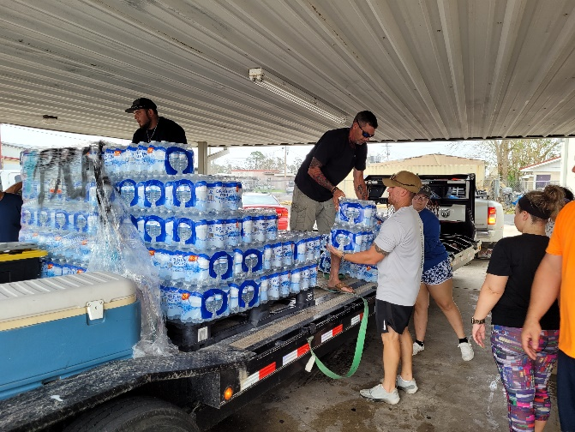
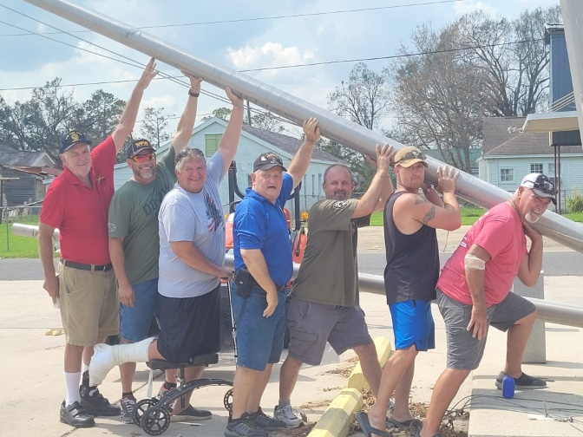
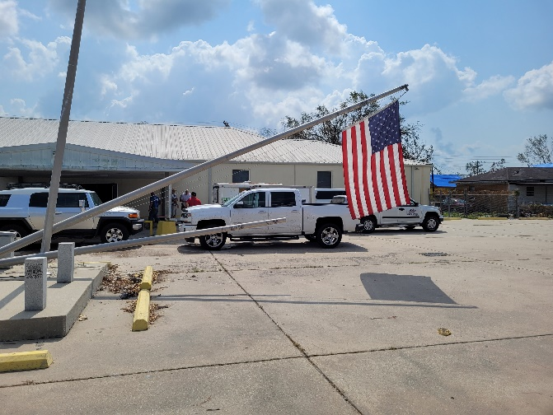
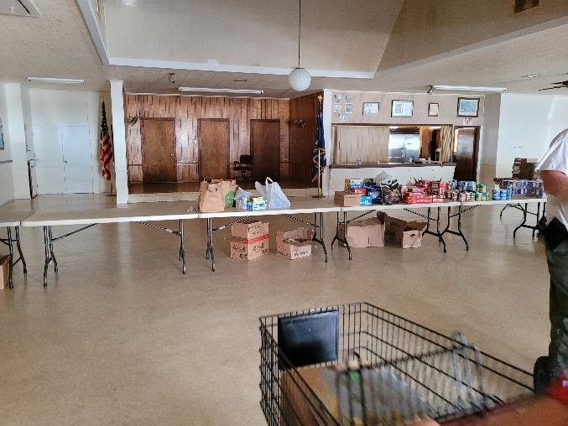
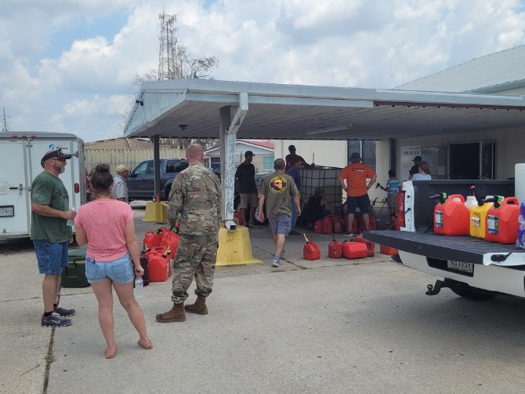
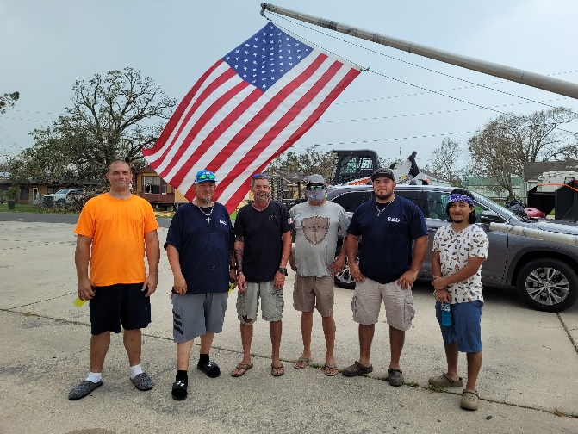
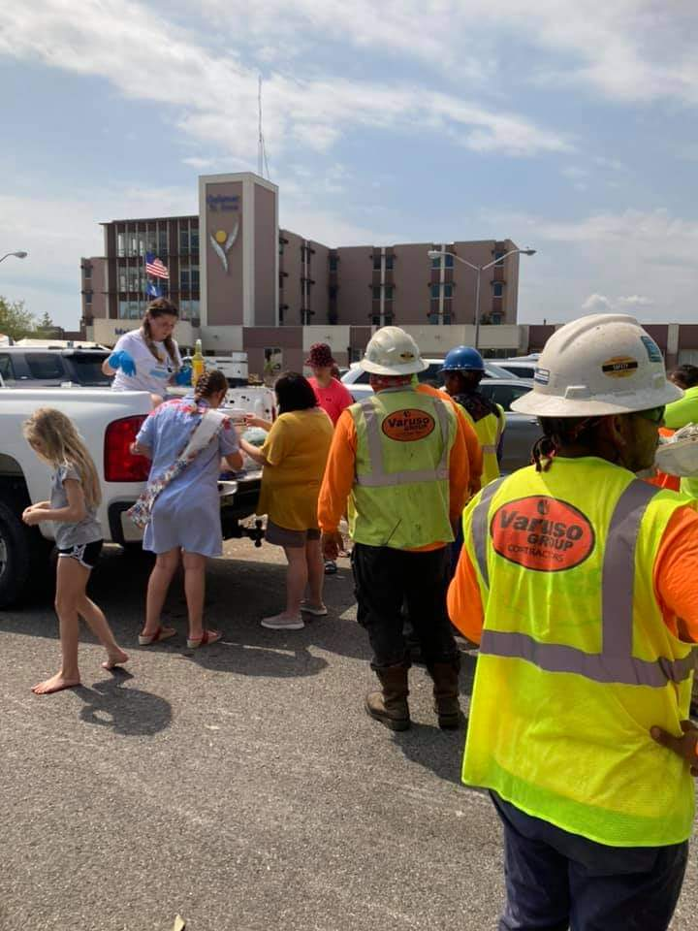
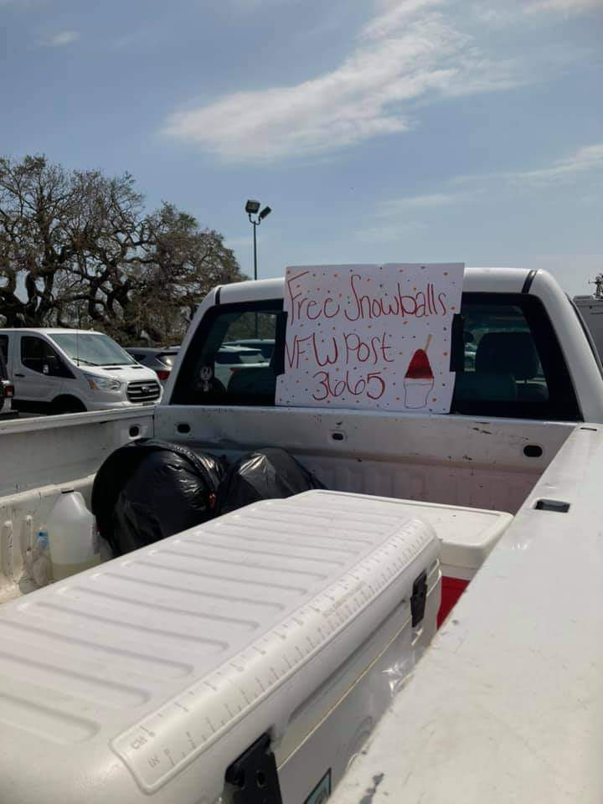
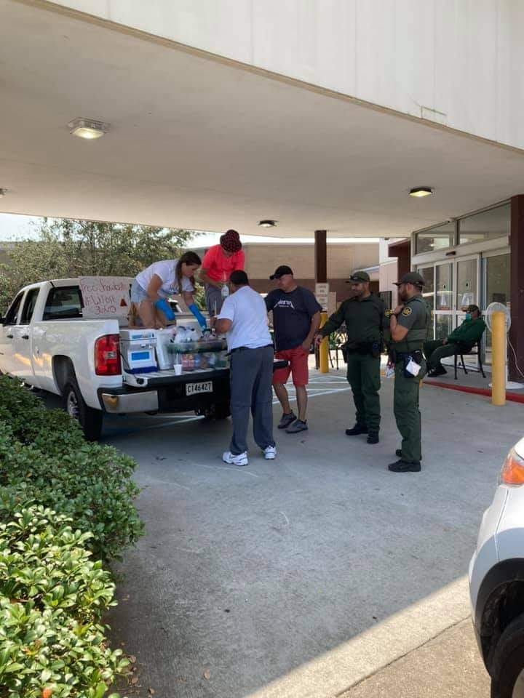
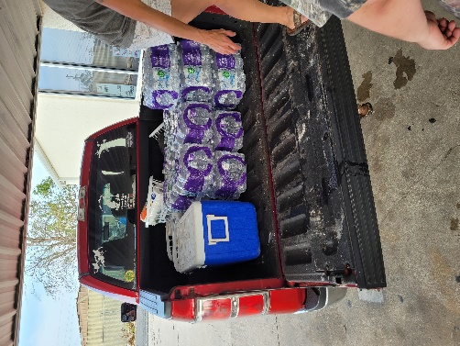
HURRICANE IDA RELIEF EFFORTS
Comrades and Auxiliary members working long hours to receive food, supplies, and donations from other VFW Post, VSO’s and non-profits organizations across the Nation to provide relief after Hurricane IDA. Comrades and Auxiliary members organized and distributed food and supplies to members, Veterans and community members

Slide 22
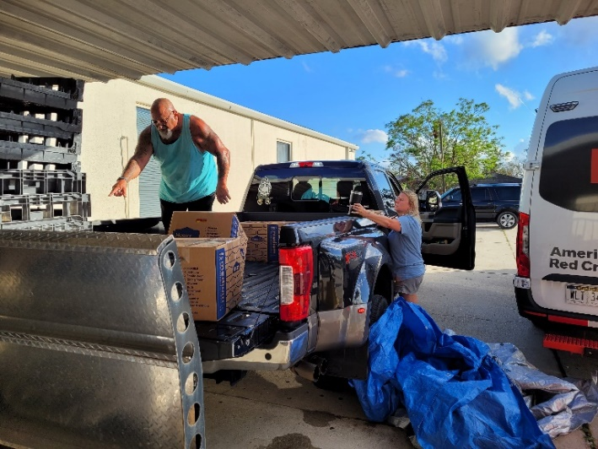
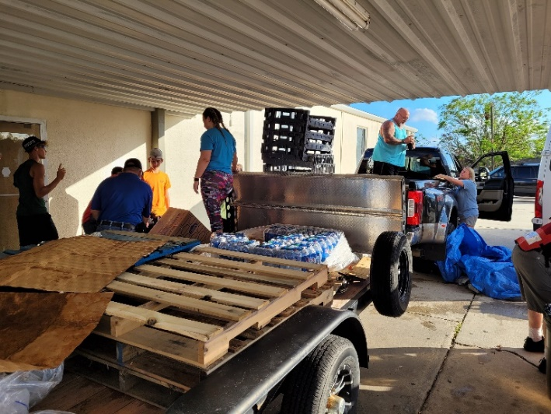
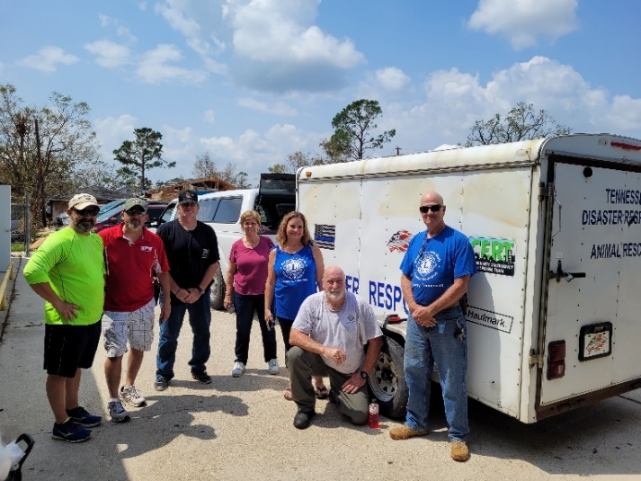
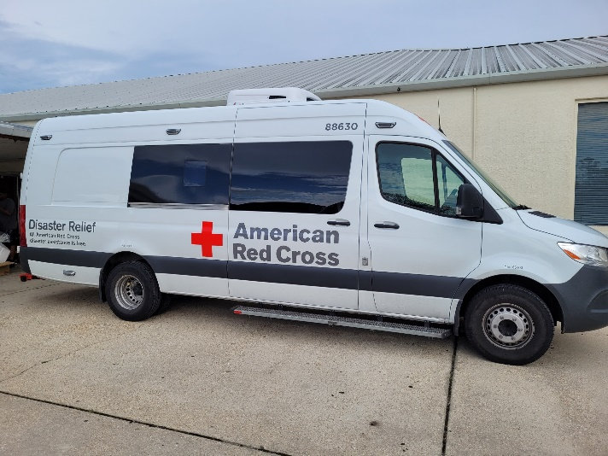
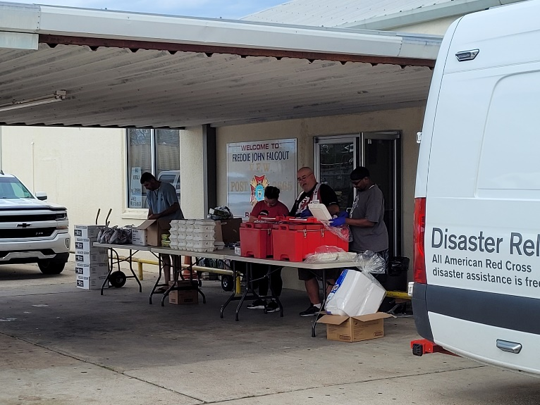
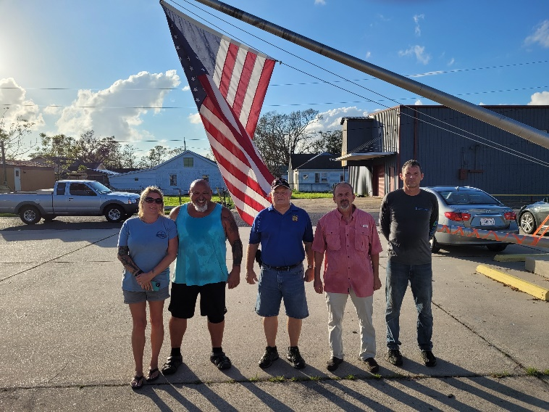
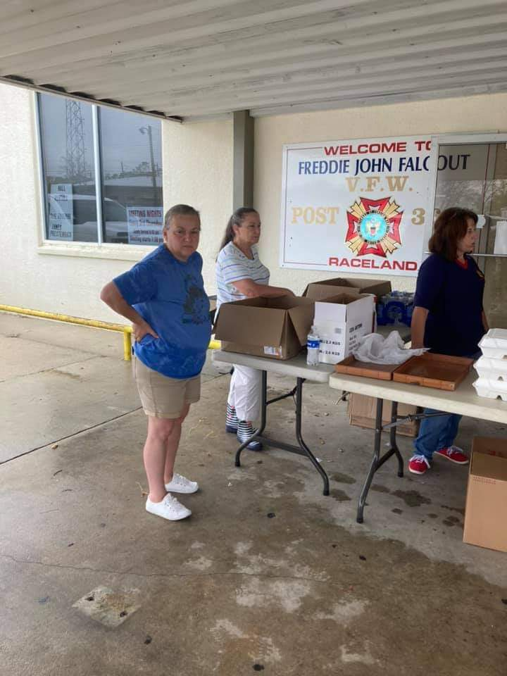
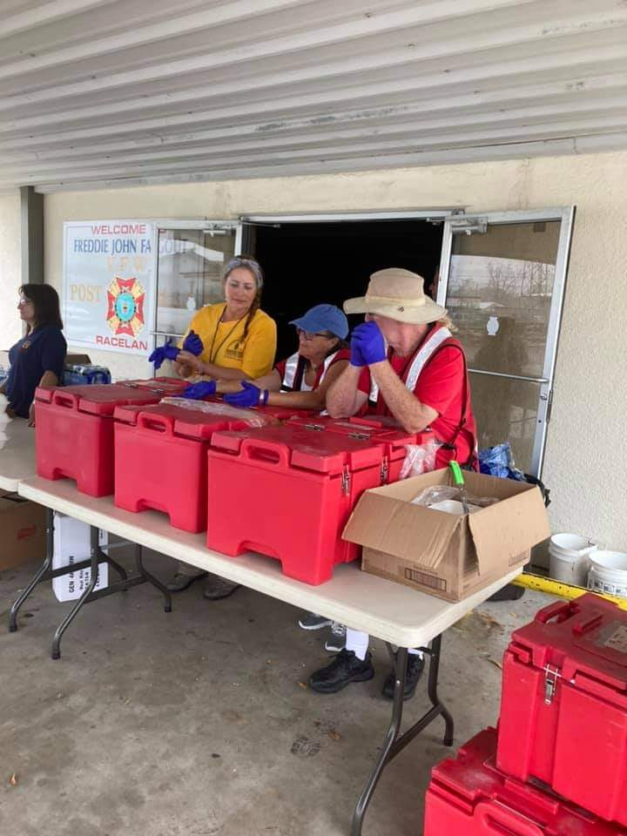
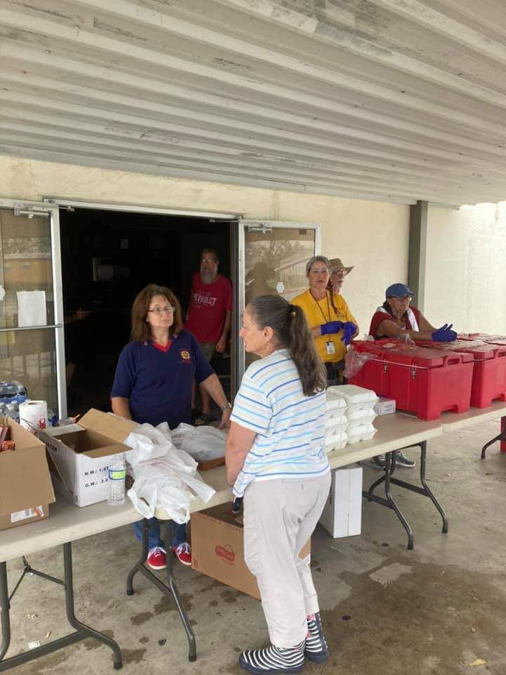
HURRICANE IDA RELIEF EFFORTS CONTINUE
Comrades and Auxiliary members partnering up with American Red Cross to provide approximately 650 hot meals a day to members, Veterans and Community. Comrades and Auxiliary members continue to receive and distribute food and supplies.

Slide 23
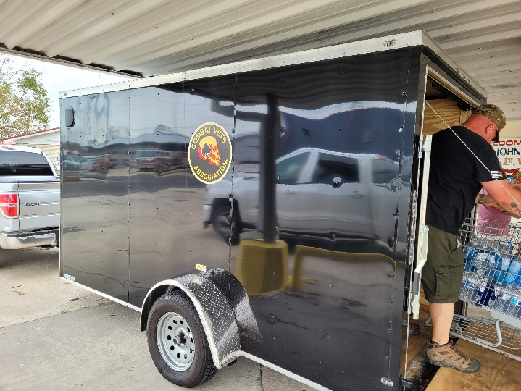
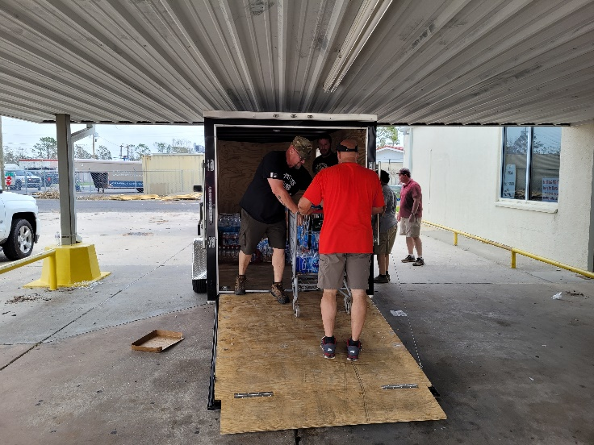
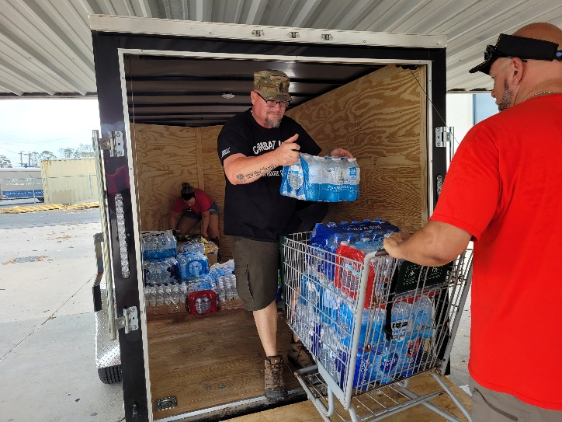
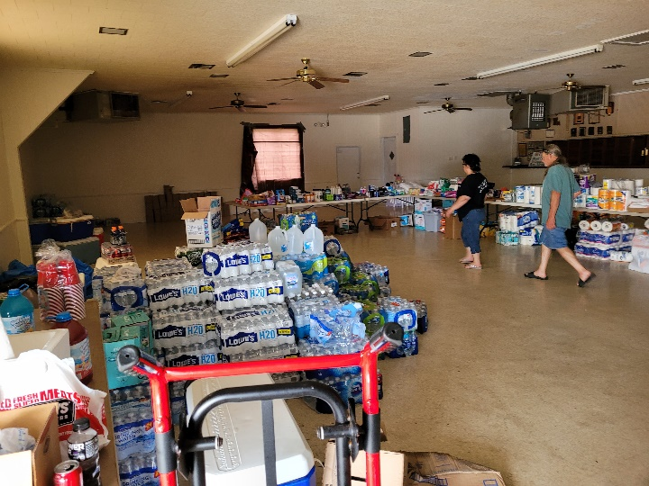
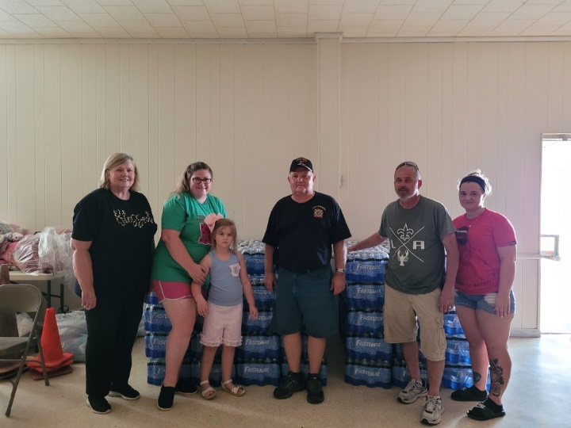
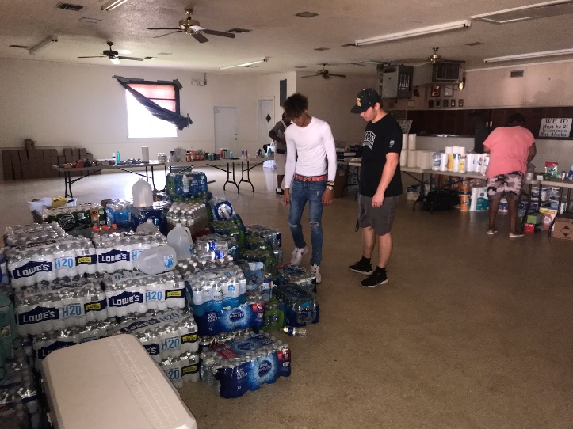
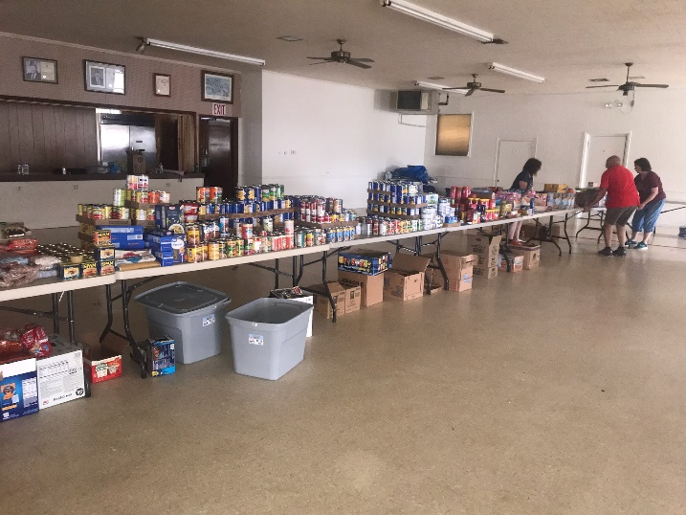
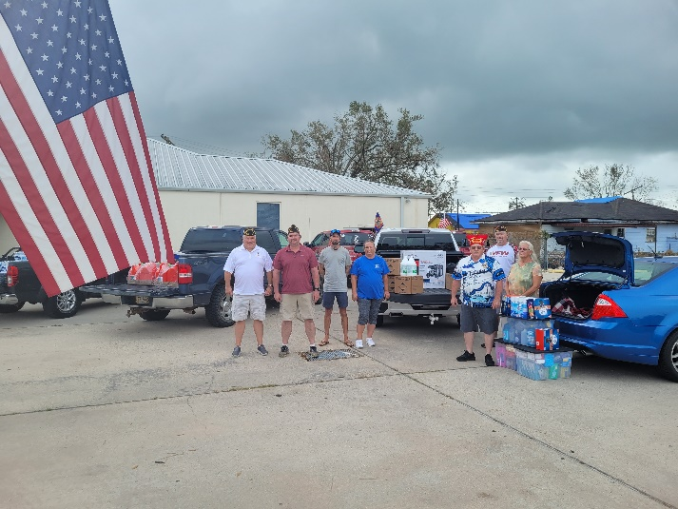
HURRICANE IDA RELIEF EFFORTS CONTINUE
Comrades and Auxiliary members continue throughout the month of September receiving and distributing supplies to members, Veterans and the community.

Slide 24
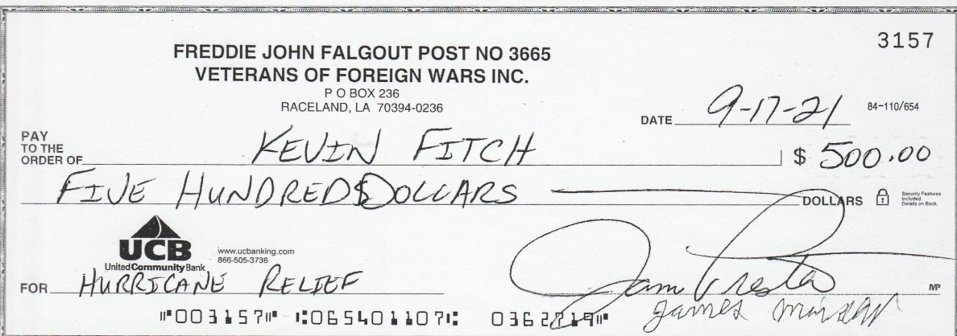
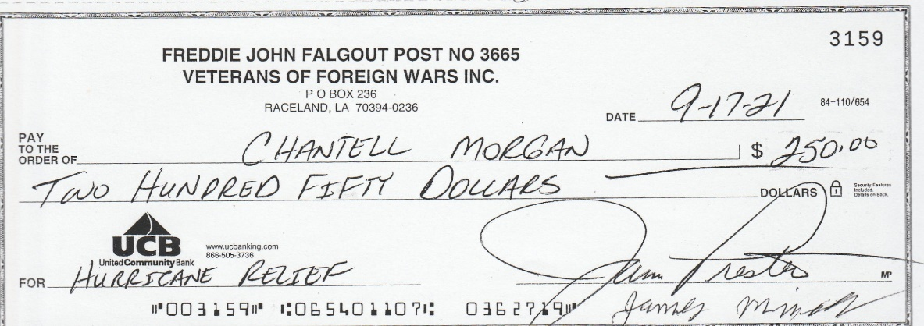
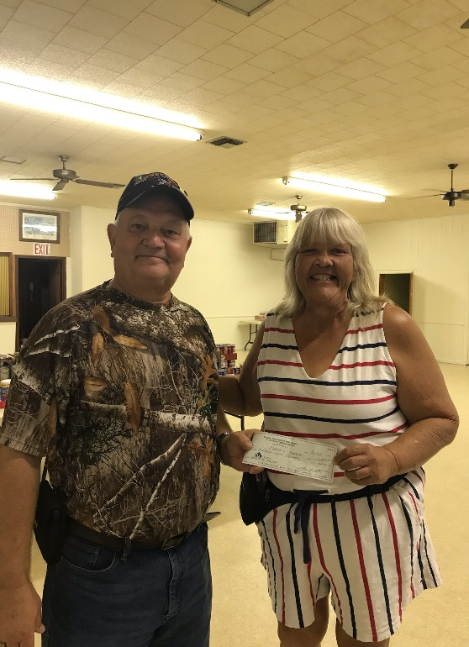
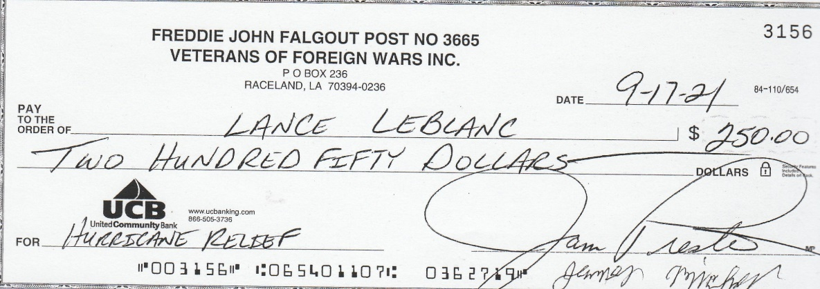
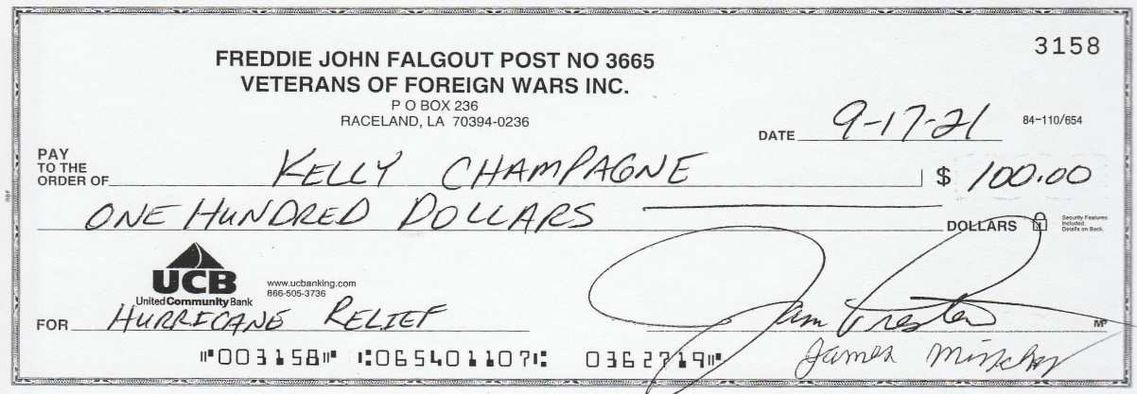
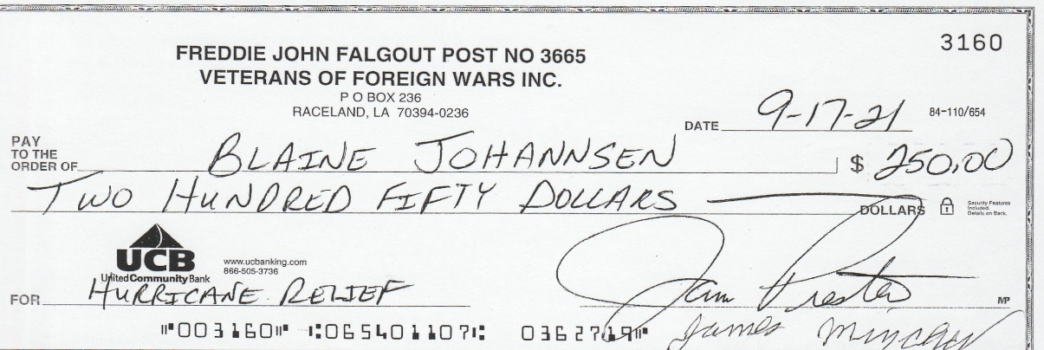
HURRICANE IDA RELIEF DONATIONS
Members and Veterans in the community that lost everything due to Hurricane Ida. Post donated money to assist these individuals with their recovery efforts.

Slide 25
OCTOBER 2021
COMMUITY SERVICE: YES
CITIZENSHIP EDUCATION: YES
SAFETY PROGRAMS: YES
YOUTH ACTIVITIES: YES
NAMS: YES
LEGISLATIVE ACTION
HOSPITAL: YES
MOTORCYLE RIDERS GROUP:

Slide 26
OCTOBER 2021
TOTAL PERSONS SERVED: 387 TOTAL FUNDS USED/DONATED: $26,793.29 TOTAL HOURS WORKED: 25
Hospital - 10/4/2021 - Visit Veterans (Hosp & Home) - Members checked on elderly members E Orgeron and T Pemberton after Hurricane Ida. Also checked on Aux. Member A Comeaux.
Community Service - 10/5/2021 - Aid to others - Donated a 10 cases of water and a $50.00 gift card to the Country Club Community Home on Thibodaux (Elderly Living).
Community Service - 10/8/2021 - Aid to others - Partnered up with Second Harvest Food Bank to distribute food and supplies to the community for Hurricane Relief Efforts. Patterson Post 12182 also brought supplies to the post to distribute. Community Service - 10/13/2021 - Aid to others - Partnered up with Second Harvest Food Bank to receive and distribute clothes, shoes, small gadgets, phone cases and other misc items. Prepared a few care packages for needy families.
Community Service - 10/15/2021 - Aid to others - Chand LLC/United Coast Guard donated 84 brand new mattresses to VFW Post 3665. Mattresses valued $282.42 a piece and totaled $23,723.28. VFW Post 3665 donated 42 mattresses to the Terrebonne Parish Sheriff's Office and 42 to Lafourche Parish Sheriff's Office. Mattresses were distributed to the lower Terrebonne and Lafourche Parishes who were severely affected by Hurricane Ida. Mattresses were distributed to those in need.
Hospital - 10/18/2021 - Visit Veterans (Hosp & Home) - Members checked on Elderly members E Orgeron and T Pemberton. Also check on our Gold Star Mother. Safety Programs - 10/29/2021 - Award recognition First Responder - Purchased First Responder medals and certificates for our upcoming awards banquet. Citizenship Education - 10/29/2021 - National Teacher Award - Purchased certificates for our Teacher entries for our upcoming awards banquet.
Youth Activities - 10/29/2021 - Voice Of Democracy - Purchased VOD medals and certificates for our upcoming awards banquet.
Youth Activities - 10/29/2021 – Patriot’s Pen - Purchased Patriot's pin medal set and certificates for our upcoming awards banquet. Youth Activities - 10/29/2021 - Americanism Cat1 - Purchased Americanism certificates for our upcoming awards banquet. NAMS - 10/30/2021 - Veterans family support - Comrades held a small fundraiser at the local Walmart for Veterans &amp; Military Support. Comrades raised $113.63. Funds were donated to the Most Urgent Veterans & Family Military support in need on the National Webpage.

Slide 27
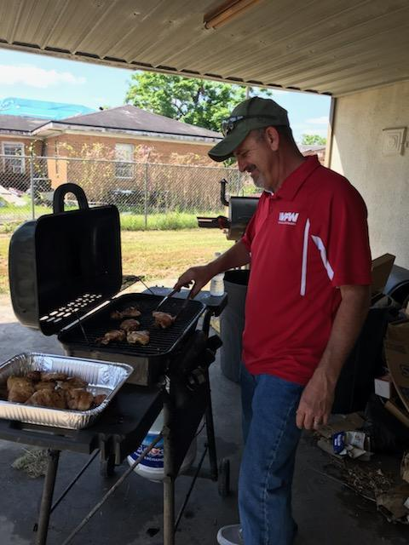
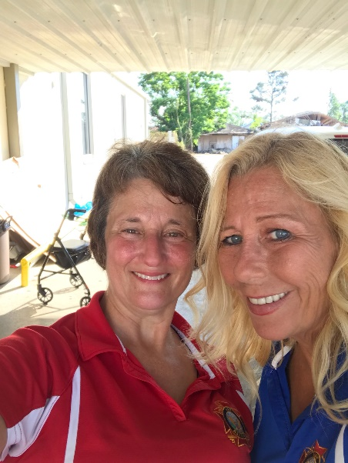
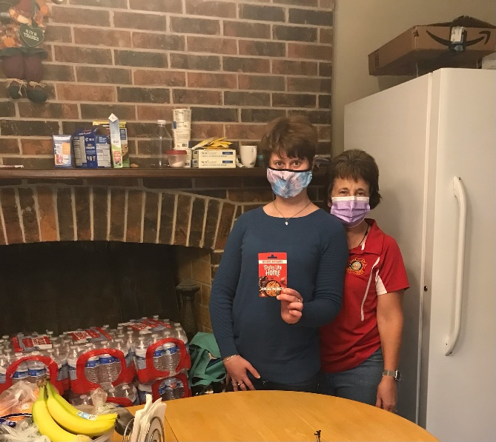
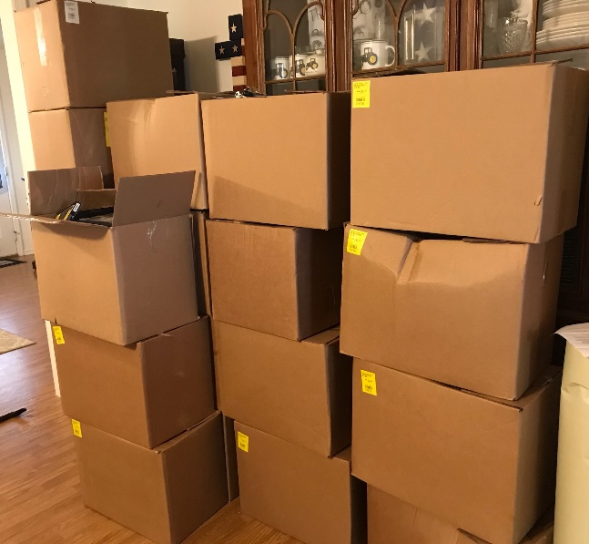
Hurricane Ida relief efforts continued. Partnering up with Second Harvest Food Bank to provide food and supplies to the community. Also hosting the State to provide Hurricane Relief checks to members.
Chand LLC/United Coast Guard donated 84 brand new mattresses to VFW Post 3665. Mattresses valued $282.42 a piece and totaled $23,723.28. VFW Post 3665 donated 42 mattresses to the Terrebonne Parish Sheriff's Office and 42 to Lafourche Parish Sheriff's Office. Mattresses were distributed to the lower Terrebonne and Lafourche Parishes who were severely affected by Hurricane Ida. Mattresses were distributed to those in need.

Slide 28
Comrades held a small fundraiser at the local Walmart for Veterans & Family Military Support. Comrades raised $113.63. Funds were donated to the Most Urgent Veterans & Family Military support in need on the National Webpage.

Slide 29
NOVEMBER 2021
COMMUITY SERVICE: YES
CITIZENSHIP EDUCATION: YES
SAFETY PROGRAMS: YES
YOUTH ACTIVITIES: YES
NAMS:
LEGISLATIVE ACTION
HOSPITAL: YES
MOTORCYLE RIDERS GROUP:

Slide 30
NOVEMBER 2021
TOTAL PERSONS SERVED: 41 TOTAL FUNDS USED/DONATED: $2,746.51 TOTAL HOURS WORKED: 23
Youth Activities - 11/18/2021 – Patriot’s Pen - Annual Awards Banquet. Awarded 1st, 2nd and 3rd place winners with certificates and cash money. Hospital - 11/15/2021 - Members checked on Elderly members E Orgeron and T Pemberton. Also checked on Aux Member A Comeaux. Youth Activities - 11/18/2021 - Americanism Cat3 - Annual Awards Program. Awarded 1st, 2nd & 3rd place winners their certificates and cash money. Safety Programs - 11/18/2021 - Award recognition Firefighter / Law Enforcement / EMTS - Annual Awards Program. Awarded 2 Law Enforcement Officers, 2 EMT's and 1 Fire Fighter with certificates, medals and cash money.
Community Service - 11/21/2021 - Aid to others - Members prepared and delivery Thanksgiving Baskets to needy families in the community. Baskets included food and a $10.00 gift card.
Community Service - 11/24/2021 - Aid to persons or family with tragedy / illness - Donated 10 gallons of gasoline to a disabled local fisherman in the community. His wife was just diagnosed with cancer.
Youth Activities - 11/18/2021 - Americanism Cat4 - Annual Awards Program. Awarded 1st, 2nd and 3rd place winners with their certificates and cash money. Youth Activities - 11/18/2021 - Voice of Democracy - Annual Awards Banquet. Awarded 1st, 2nd & 3rd place winners with their certificates and cash money. Youth Activities - 11/18/2021 - Americanism Cat1 - Annual Awards Banquet. Awarded Cat I 1st, 2nd & 3rd place winners with their certificates and cash money. Citizenship Education - 11/18/2021 - National Teacher Award - Annual Awards Program. Awarded 3 Elementary Teachers with their certificates and cash money. Community Service - 11/21/2021 - Aid to others - Post donated $500.00 to WWII member Woodrow Dufrene. Comrade lost everything due to Hurricane Ida. Youth Activities - 11/18/2021 - Americanism Cat2 - Annual Awards Program. Awarded 1st, 2nd & 3rd place winners their certificates and cash money.

Slide 31
Annual Awards Banquet. Awarded 1st, 2nd & 3rd place Americanism, Patriot’s Pen & Voice Democracy winners with certificates, medals and cash. Also awarded Teachers, Law Enforcement, EMT’s and Fire Fighters. Over 120 people!

Slide 32
Auxiliary members preparing and distributing 10 Thanksgiving baskets to needy people in the community. Baskets contained food and a $10.00 gift card.

Slide 33
DECEMBER 2021
COMMUITY SERVICE: YES
CITIZENSHIP EDUCATION:
SAFETY PROGRAMS:
YOUTH ACTIVITIES:
NAMS:
LEGISLATIVE ACTION: YES
HOSPITAL:
MOTORCYLE RIDERS GROUP:

Slide 34
DECEMBER 2021
TOTAL PERSONS SERVED: 34 TOTAL FUNDS USED/DONATED: $1,789.68 TOTAL HOURS WORKED: 18.5
Community Service - 12/5/2021 - Aid to others - 2 Comrades cleared out the church threw out trash and tarped their roof.
Community Service - 12/10/2021 - Aid to others – Comrade Dalgo helped a college student move from her dorm into a family apartment at NSU because she did not have a truck. As well as donated a truck of furniture. Community Service - 12/11/2021 - Make a difference day - Cooked and served a meal to 3 families in another church that was in need due to a personal situation. Community Service - 12/13/2021 - Aid to others – Comrade Dalgo volunteered to cut 4 young guys' hair that are missionaries with the church of Jesus Christ of the Latter-Day Saints from other parts of the United States.
Legislative Action - 12/15/2021 - Calls, Letters, personal contact with Legislators to support legislation favorable to Vets - Emailed Representative Steve Scalise, Senator Bill Cassidy &amp; Senator John Kennedy urging them to tell Congress to Support the COST of War Act and the Honoring our PACT Act!.
Community Service - 12/17/2021 - Aid to others - Post donated $500.00 to the VFW Department of Kentucky's tornado disaster relief fund. Funds will be used to help Veterans affected by the recent tornado.
Community Service - 12/18/2021 - Aid to others - Donation $250.00 to Vietnam Veteran Eugene Pete for Hurricane Ida disaster relief. Veteran's home was severely damaged from Hurricane Ida. Community Service - 12/18/2021 - Aid to others - Donated $250.00 to Veteran Matt Boudreaux (Marine) for Hurricane Ida disaster relief. Veteran's home was affected by Hurricane Ida.

Slide 35
Donations to Veterans in need after Hurricane Ida and to the VFW Department of Kentucky’s tornado disaster relief fund.

